Slide 1

GUI Applications: Introduction to Tkinter module; Creating windows and frames
Python Programming | GUI Applications
Course: Python Programming | Chapter: GUI Applications | Bachelor of Computer Science and Engineering
DISCOVER · LEARN · EMPOWER
Notes:
Welcome to today's lecture on building Graphical User Interfaces in Python. We will focus specifically on the Tkinter module, which is the standard library for creating desktop applications. By the end of this session, you will understand how to construct the foundational elements of any GUI application.

Slide 2
Course Outcomes
SLIDE 2 / 14
Course Outcome
CO | BT LEVEL | DESCRIPTION
CO1 | BT1 | Understand the syntax, control structures, and basic constructs of Python programming language
CO2 | BT3 | Apply functions, modules, and exception handling for modular program development
CO3 | BT3 | Implement data structures including lists, tuples, dictionaries, and sets for efficient data processing
CO4 | BT4 | Analyze and manipulate files, strings, and perform data handling operations
CO5 | BT5 | Design and develop real-world applications integrating multiple Python concepts
Chandigarh University
2 / 14
Notes:
This lecture directly addresses our Course Outcomes. CO1 is met as we apply Python syntax and control structures to instantiate GUI objects. CO4 is relevant because GUI applications often serve as the interface for manipulating and displaying data from files and strings.

Slide 3
Learning Objectives
SLIDE 3 / 14
Learning Outcomes
1
Analyze the role of the Tkinter module as the standard GUI toolkit for Python.
2
Evaluate the necessity of the root window as the primary container for all widgets.
3
Construct a functional application window using the Tk() class and geometry managers.
4
Differentiate between the root window and frame containers for organizing complex layouts.
5
Synthesize a basic GUI structure that integrates windows and frames effectively.
Chandigarh University
3 / 14
Notes:
Our goal is to move beyond simple scripts to building interactive applications. You will learn to analyze why Tkinter is essential and evaluate how the root window acts as the backbone of your interface. We will construct and differentiate between the main window and internal frames.

Slide 4
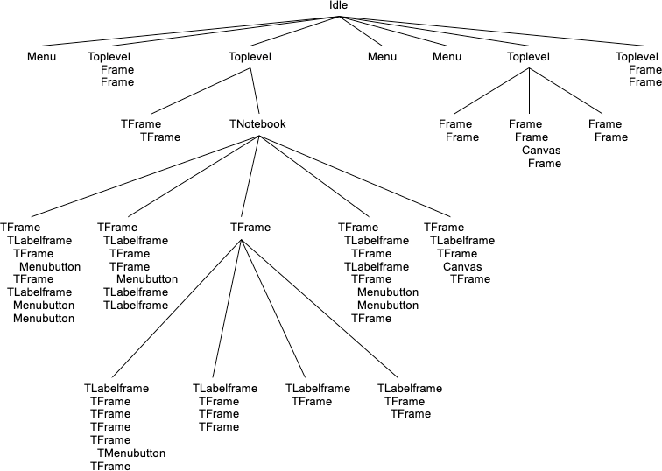
Lecture
SLIDE 4 / 14
Introduction to Tkinter Module
1
Tkinter is the standard Python interface to the Tk GUI toolkit.
2
It provides a set of widgets like buttons, labels, and entry fields.
3
The module is included in the standard Python distribution by default.
4
Tkinter uses an event-driven programming model for user interactions.
5
It supports cross-platform compatibility across Windows, macOS, and Linux.
6
Widgets are organized hierarchically within parent containers called windows or frames.
7
The module name is 'tkinter' in Python 3 and 'Tkinter' in Python 2.
TkDocs Tutorial - Tk Concepts
Chandigarh University
4 / 14
Notes:
Think of Tkinter as the bridge between your Python code and the operating system's graphical capabilities. It is event-driven, meaning the program waits for user actions like clicks or key presses. For example, a button click triggers a specific function, unlike linear scripts that run from top to bottom.

Slide 5
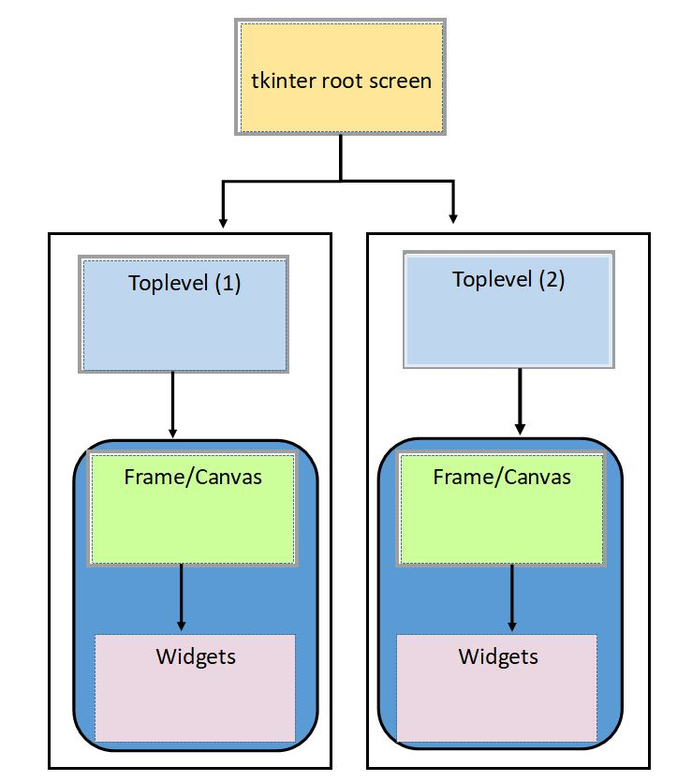
Lecture
SLIDE 5 / 14
The Root Window Concept
1
The root window is the main application window created by the Tk() class.
2
It serves as the parent container for all other widgets in the application.
3
Only one root window can exist per application instance at a time.
4
The root window manages the main event loop via the mainloop() method.
5
Properties like title and geometry are set directly on the root object.
6
Destroying the root window terminates the entire GUI application immediately.
7
The root window handles system-level events like minimizing or closing the app.
Ex: Multi-Screen Strategy Demo – wikiPython (source: www.wikipython.com)
Chandigarh University
5 / 14
Notes:
The root window is the foundation of your GUI. You create it using the Tk() constructor, and it acts as the parent for everything else. Without the root window, there is no application. Remember, calling root.mainloop() starts the event loop that keeps the window open and responsive.

Slide 6
Lecture
SLIDE 6 / 14
Creating Windows and Frames
1
Frames are rectangular containers used to group related widgets together visually.
2
Frames allow for modular design by isolating sections of the interface.
3
A frame can be placed inside the root window or inside another frame.
4
Frames do not have a visible border by default unless configured explicitly.
5
They help organize complex layouts by dividing the screen into logical zones.
6
The Frame class is imported from the tkinter module for instantiation.
7
Frames are essential for creating tabbed interfaces or split-screen layouts.
Ex: Multi-Screen Strategy Demo – wikiPython (source: www.wikipython.com)
Chandigarh University
6 / 14
Notes:
While the root window is the main container, frames are the internal organizers. Imagine a frame as a box within the main window where you place specific controls. This modularity makes your code cleaner and your interface easier to manage. You can nest frames inside frames to create complex, multi-layered layouts.

Slide 7
Geometry Management
SLIDE 7 / 14
pack()
1
The pack() manager arranges widgets in blocks, typically top or bottom.
2
It automatically calculates the size of the widget based on its content.
3
The fill parameter allows widgets to expand to fill available space.
4
The side parameter determines the alignment: left, right, top, or bottom.
5
Pack is the simplest geometry manager for linear and basic layouts.
6
It handles spacing automatically using the padx and pady options.
7
Nested pack calls can lead to layout conflicts if not managed carefully.
Chandigarh University
7 / 14
Notes:
The pack manager is like stacking boxes on a shelf. You tell it to place a button at the top, and it does so automatically. For example, if you pack a label with side=TOP, it sits at the top of the frame. It is ideal for simple vertical or horizontal arrangements.

Slide 8
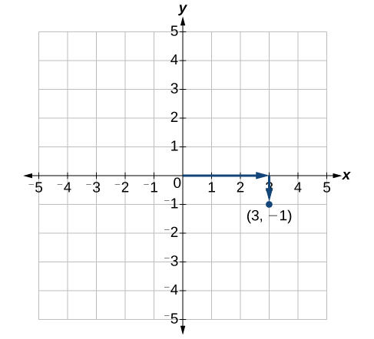
Geometry Management
SLIDE 8 / 14
place()
1
The place() manager positions widgets at absolute x and y coordinates.
2
It requires explicit width and height specifications for precise control.
3
Use place() when exact pixel positioning is critical for the design.
4
It ignores the natural size of the widget unless dimensions are set.
5
The relx and rely parameters allow relative positioning based on container size.
6
Absolute positioning can break layouts when the window is resized.
7
It is less flexible than pack() for dynamic or responsive interfaces.
Source: s3-us-west-2.amazonaws.com
Chandigarh University
8 / 14
Notes:
The place manager gives you pixel-perfect control. You specify exactly where a widget goes, like placing a button at x=100 and y=50. However, this rigidity means your layout might break if the user resizes the window. Use it sparingly for elements that must stay in a fixed spot.

Slide 9
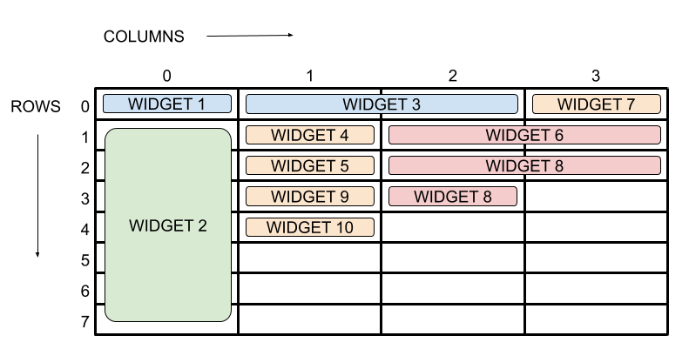
Geometry Management
SLIDE 9 / 14
grid()
1
The grid() manager arranges widgets in a row-column matrix structure.
2
It is ideal for forms, tables, and complex data entry interfaces.
3
Widgets are placed using row and column indices starting from zero.
4
The sticky parameter controls alignment within the grid cell.
5
It handles resizing automatically by distributing space among columns and rows.
6
Grid is often the most robust choice for structured GUI layouts.
7
You can merge cells using the columnspan and rowspan parameters.
Source: www.pythonguis.com
Chandigarh University
9 / 14
Notes:
The grid manager is like a spreadsheet. You place a label in row 0, column 0, and an entry box in row 0, column 1. It is perfect for login forms where you need strict alignment. Unlike pack, it handles resizing gracefully by expanding columns as the window grows.

Slide 10
Worked Example
SLIDE 10 / 14
Basic Window
GOVERNING EQUATION
Create a root window: root = Tk(); root.title('My First App')
SET WINDOW SIZE
root.geometry('400x300+100+100').
ADD A FRAME
frame = Frame(root, bg='lightblue', width=200, height=100).
PLACE A LABEL
Label(frame, text='Hello Tkinter').pack().
PACK THE FRAME
frame.pack(padx=20, pady=20).
START THE LOOP
root.mainloop().
• This code creates a blue frame with a centered label inside.
Chandigarh University
10 / 14
Notes:
Let's look at a concrete example. We create a root window and set its title to 'My First App'. We then create a frame with a light blue background. Inside that frame, we place a label. Finally, we pack the frame into the root and start the main loop. This sequence creates a visible, interactive window.

Slide 11
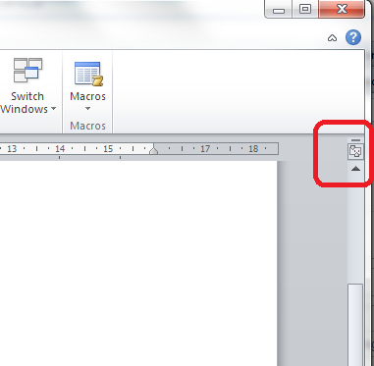
Worked Example
SLIDE 11 / 14
Frame Layout
GOVERNING EQUATION
Place a button in the left frame: Button(left_frame, text='Click').pack()
DEFINE TWO FRAMES
left_frame and right_frame inside the root.
PLACE A LABEL IN THE RIGHT FRAME
Label(right_frame, text='Info').pack().
USE GRID TO ARRANGE FRAMES
left_frame.grid(row=0, column=0).
USE GRID TO ARRANGE FRAMES
right_frame.grid(row=0, column=1).
CONFIGURE COLUMN WEIGHTS
root.columnconfigure(0, weight=1).
• This creates a split-screen layout with interactive elements on both sides.
Source: libroediting.com
Chandigarh University
11 / 14
Notes:
Here we create a split-screen layout. We define two frames and place different widgets in each. By using the grid manager, we place the left frame in column 0 and the right frame in column 1. This allows us to organize complex interfaces where different sections have distinct functions.

Slide 12
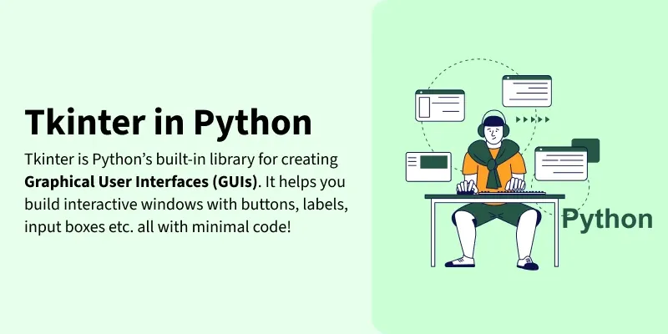
Lecture
SLIDE 12 / 14
Common Pitfalls in Tkinter
1
Mixing pack() and grid() managers in the same parent container causes errors.
2
Forgetting to call mainloop() results in a window that closes instantly.
3
Creating multiple root windows leads to unpredictable application behavior.
4
Not configuring geometry managers can result in widgets being hidden.
5
Using absolute coordinates with place() breaks layouts on different screen sizes.
6
Ignoring the event loop can cause the GUI to freeze during processing.
7
Overusing nested frames can make the code difficult to read and maintain.
Create First GUI Application using Python-Tkinter - GeeksforGeeks (source: media.geeksforgeeks.org)
Chandigarh University
12 / 14
Notes:
There are common mistakes students make. Never mix pack and grid in the same container; it will crash your app. Always remember to call mainloop() at the end of your script. Also, avoid creating multiple root windows, as Tkinter expects exactly one main window per application.

Slide 13
Lecture
SLIDE 13 / 14
Key Takeaways
1
Tkinter is the standard library for building cross-platform GUI applications.
2
The root window is the essential parent container for all GUI elements.
3
Frames provide modular containers for organizing widgets into logical groups.
4
Geometry managers (pack, grid, place) control the layout and positioning of widgets.
5
Event-driven programming allows the application to respond to user interactions.
Chandigarh University
13 / 14
Notes:
To summarize, Tkinter is your tool for building interfaces. The root window is the foundation, and frames help you organize your content. Remember that geometry managers dictate how your widgets are arranged. Finally, always keep the event loop running to ensure your application remains responsive.

Slide 14
Lecture
SLIDE 14 / 14
References
PYTHON
A Practical Learning Approach, 1st Edition — T.S. Murugesh, Shriram K. Vasudevan, Sini Raj Pulari
• Learning Python, 6th Edition — Mark Lutz
• Starting Out with Python, Global Edition, 6th Edition — Tony Gaddis
• Introduction to Python Programming and Data Structures, 3rd Edition — Y. Daniel Liang
Chandigarh University
14 / 14
Notes:
For further reading, I recommend the textbooks listed here. Mark Lutz's 'Learning Python' offers deep insights into the language. Tony Gaddis provides excellent practical examples. Y. Daniel Liang's book covers data structures well, and the book by Murugesh et al. offers a practical approach to Python programming.

